Slide 1
Flyweight Pattern

Slide 2
Intent
Use sharing to support large numbers of fine-grained objects efficiently.
16-<number>

Slide 3
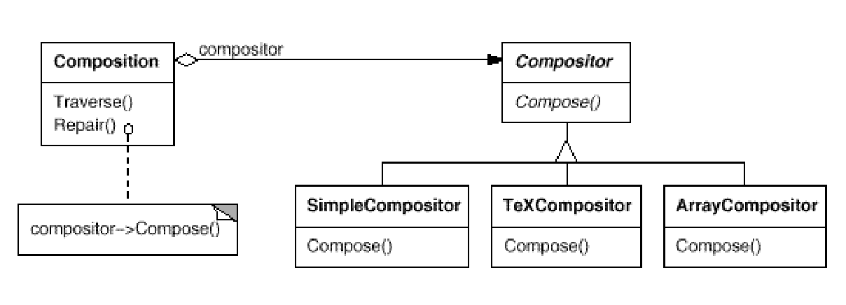
Motivation
A Composition maintains a reference to a Compositor object. Whenever a Composition reformats its text, it forwards this responsibility to its Compositor object.
The client of Composition specifies which Compositor should be used by installing the Compositor it desires into the Composition.
16-<number>

Slide 4
Motivation
A Composition maintains a reference to a Compositor object. Whenever a Composition reformats its text, it forwards this responsibility to its Compositor object.
The client of Composition specifies which Compositor should be used by installing the Compositor it desires into the Composition.
16-<number>

Slide 5
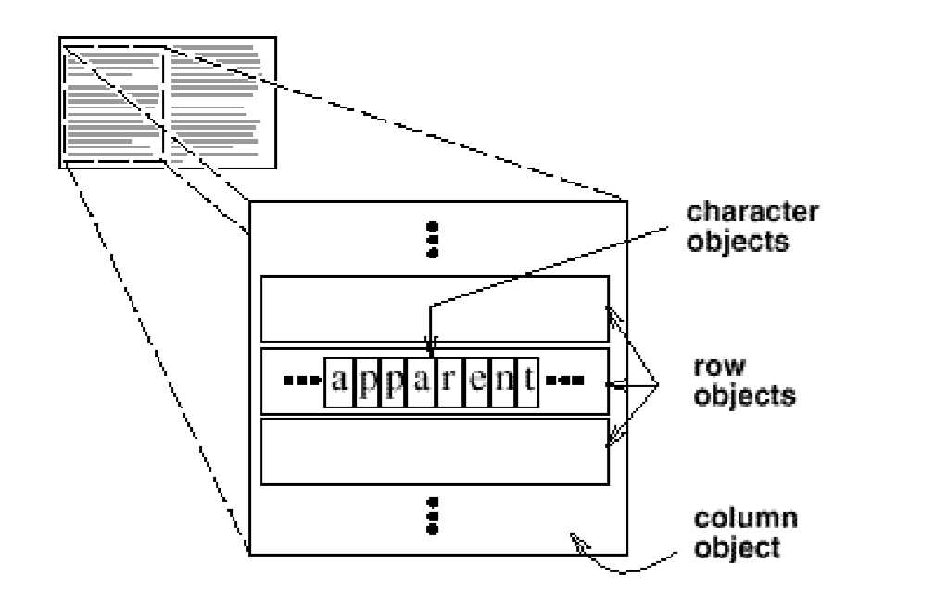
Motivation
Most document editor implementations have text formatting and editing facilities, however, they usually stop short of using an object for each character in the document.
The drawback of such a design is its cost. Even moderate-sized documents may require hundreds of thousands of character objects, which will consume lots of memory and may incur unacceptable run-time overhead.
16-<number>

Slide 6
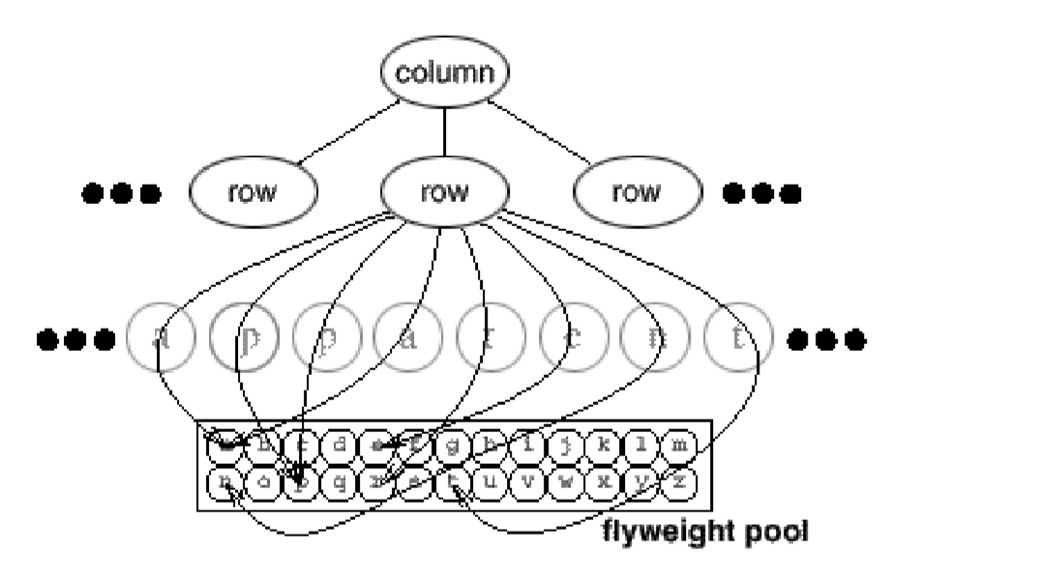
16-<number>

Slide 7
Applicability
Use the Strategy pattern when
an application uses a large number of objects.
storage costs are high because of the sheer quantity of objects.
most object state can be made extrinsic.
many groups of objects may be replaced by relatively few shared objects once extrinsic state is removed.
the application doesn't depend on object identity, since flyweight objects may be shared.
16-<number>

Slide 8
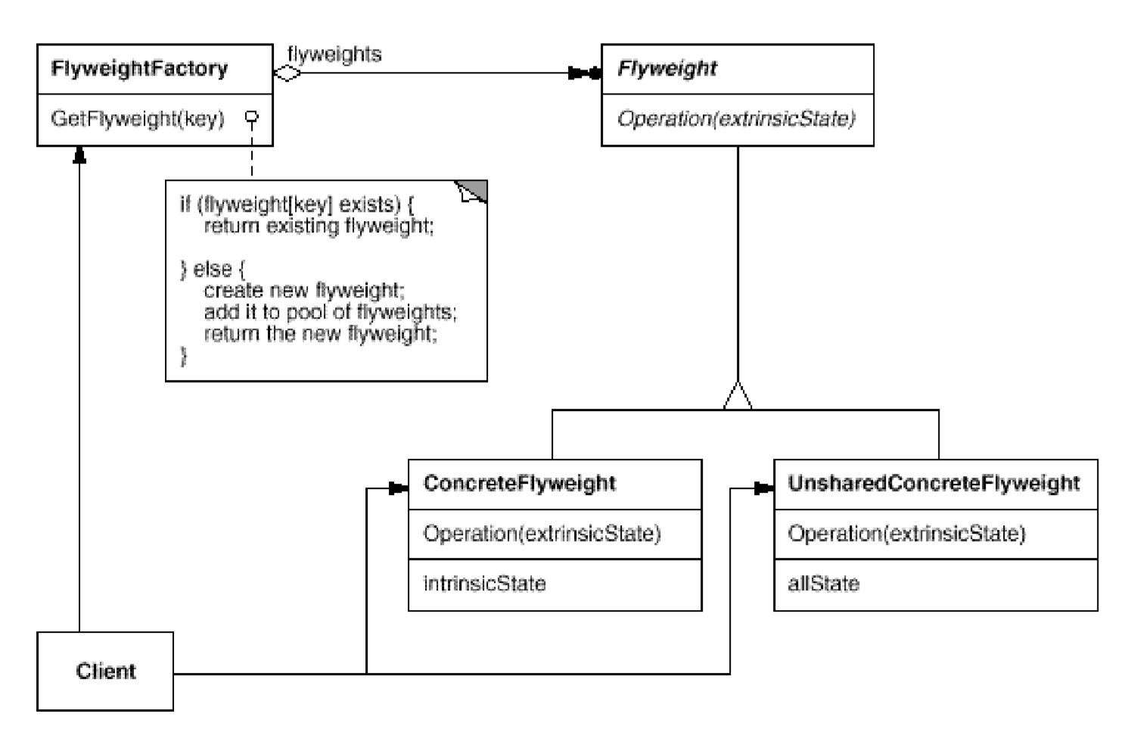
Structure
16-<number>

Slide 9
Flyweight
Use sharing to support large numbers of fine-grained objects efficiently.
Intrinsic state is stored in the flyweight; it consists of information that's independent of the flyweight's context, thereby making it sharable.
Extrinsic state depends on and varies with the flyweight's context and therefore can't be shared.
16-<number>

Slide 10

Handling Numerous Occurrences of an Object
An object may have numerous occurrences.
Representing each occurrence as an object is very costly.
Design problem: How does one represent such occurrences in a computer?
How do we represent and manipulate the small squares efficiently?
16-<number>

Slide 11
Represent Numerous Occurrences of Object
Logical representation – extrinsic state, non-sharable properties:
  position,
  typographic style, etc.
:Red Tile
:Black Tile
:Red Tile
:Black Tile
position: (1,1)
image: Image
position: (1,2)
image: Image
position: (1,3)
image: Image
position: (1,4)
image: Image
logical
physical
Physical representation – sharable, intrinsic state:
font, color, character code, image, etc.
16-<number>

Slide 12
Flyweight Pattern
Client
FlyweightFactory
*
Flyweight
flyweights
getFlyweight(key:String)
operation()
if (flyweights.get(key)==null) {
Class c=Class.forName(key);
flyweights.add(c.newInstance());
}
return flyweights.get(key);
Flyweight 1
Flyweight 2
Flyweight 3
operation()
operation()
operation()
16-<number>

Slide 13
Interaction in the Flyweight Pattern
:Flyweight
Factory
Flyweight
:Client
g:Graphics
f:=flyweights.
get(key)
f:=getFlyweight
(key)
[f==null]
create (intrinsicState)
flyweights.
add (key, f)
draw(g,x,y)
draw(c,x,y)
16-<number>

Slide 14
Applying Flyweight
if (flyweights.get(c, f, size)==null) {
Char ch=new Char (c, f, size);
flyweights.add(ch); }
return flyweights.get(c, f, size);
CharFlyweightFactory
Char
*
get (c:char, f:Font, size:int)
flyweights
create(c:char, f:Font, size:int)
draw(...)
R e p r e s e n t i n g ...
:Char
:Char
...
:Char
:Char
:Char
...
Flyweights
‘R’:char
...
‘e’:char
...
‘p’:char
...
‘r’:char
...
‘s’:char
...
16-<number>

Slide 15
Flyweight Pattern
It is the opposite of singleton
  flyweight: need to create numerous instances of a class.
  singleton: need to create at most one instance of a class.
Benefits of flyweight:
  reduces memory requirements
  improves object creation efficiency
Liabilities:
  May incur run time overhead to search, transfer and compute extrinsic state.
16-<number>

